Slide 1

NEOFLIX | Video reflection of (acute) neonatal interventions
Veerle Heesters
Ruben Witlox, Arjan te Pas
Leiden university medical center

Slide 2


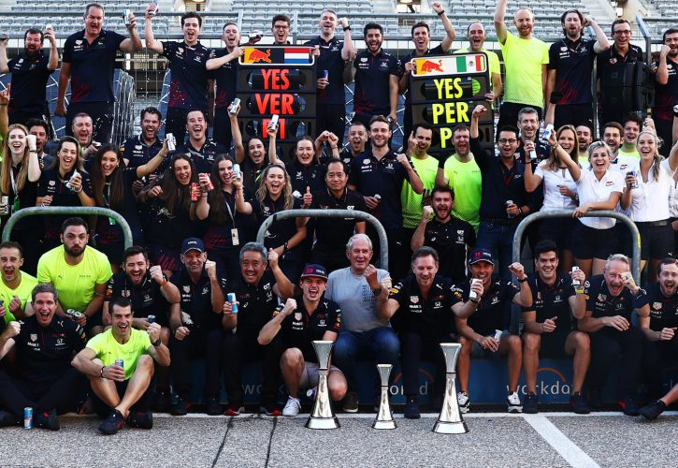
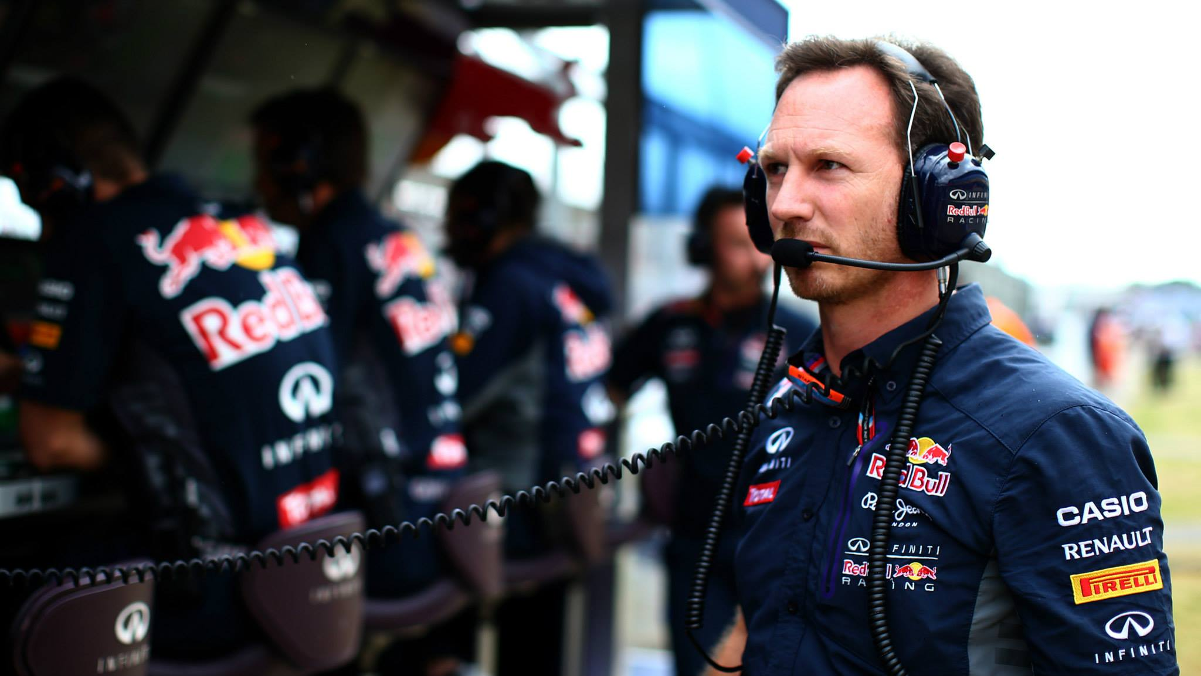
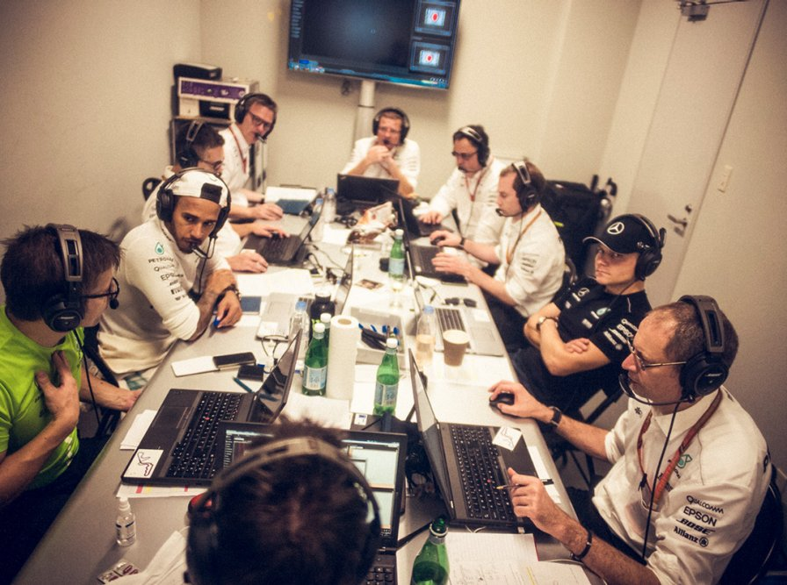
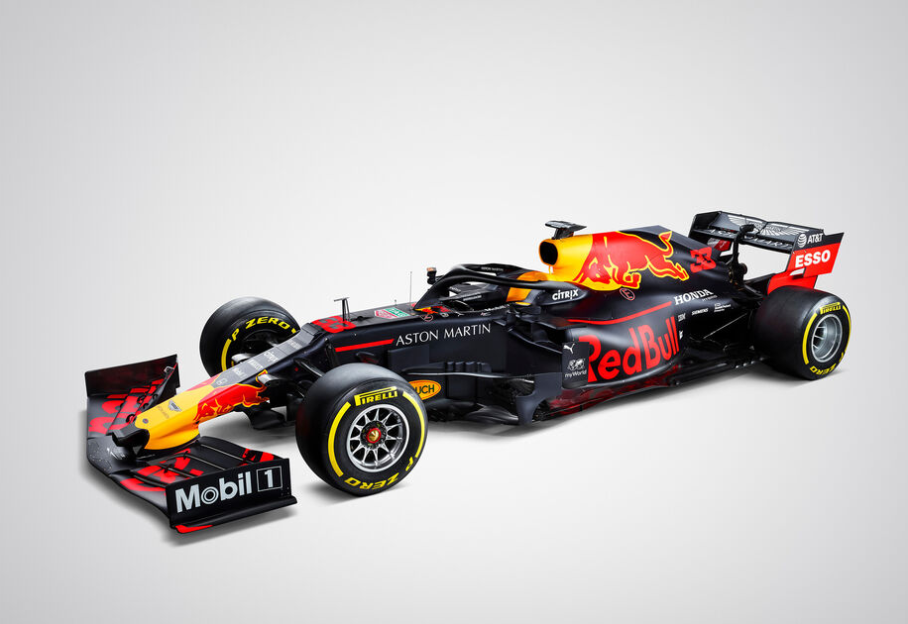
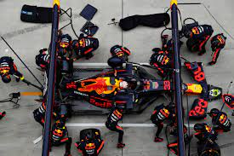
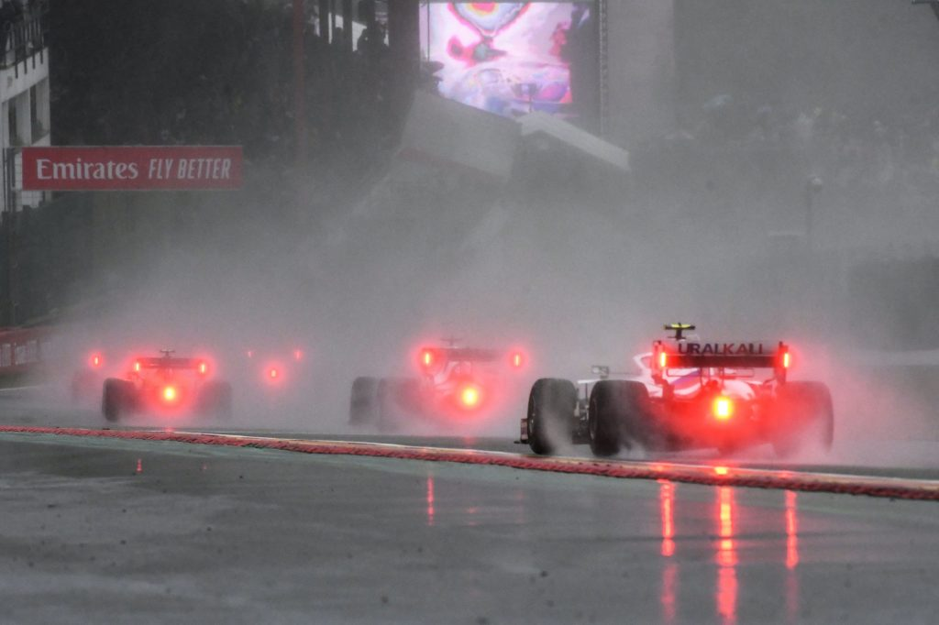
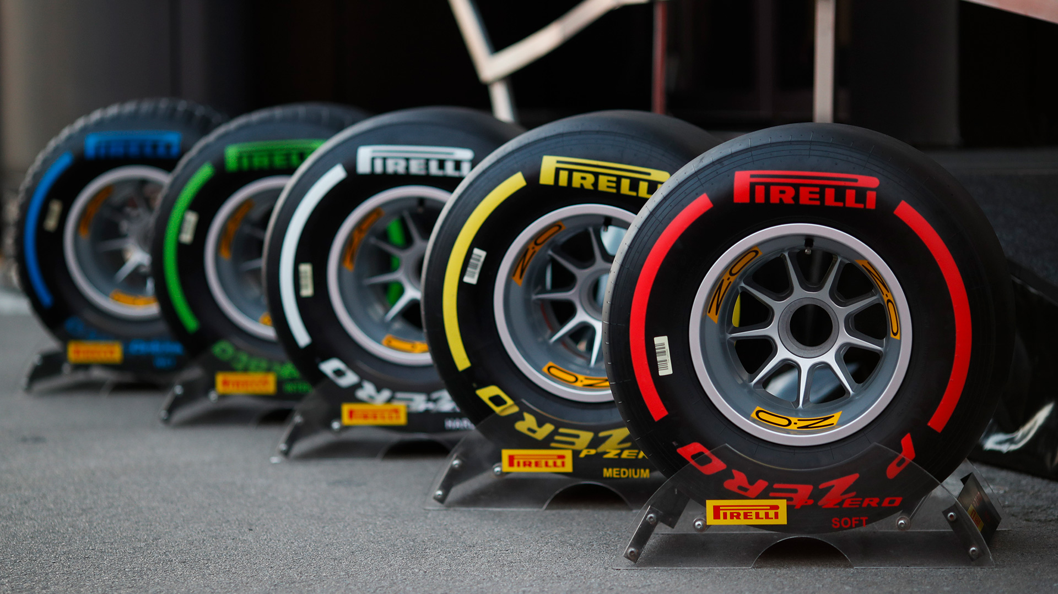
Formula 1
Data
Emergent nature
Dynamic
Lots of factors have effect on the outcome
Multidisciplinary
Team debrief
Notes:
How:
Debrief with the factory, on track, combining all their inputs
One of the most data driven sports in history.
Over 200 sensors that collect data on the car for analysis
Dynamic
Multi-disciplinary
Exciting
Fast
https://www.mercedesamgf1.com/en/news/2018/03/insight-how-an-f1-team-debriefs-after-a-race/
Before I walk you trough the steps our department has taken to come to this, I want to start with explaining the goal of video reflection with an example of Formula 1. It is a sport that has an emergent nature, it is very dynamic, and many factors (also some that you can’t influence) have an effect on the outcome. For the fans, look at the final grand prix of this year, where Max Verstappen won the race; this was a very unexpected outcome. To win the race, the drivers work together with all the people on track, the engineers and mechanics in the factory and many others.
So how do you win a race? Formula 1 is one the most data driven sports in history. A car has over 200 sensors that genenerate data during the race. and the key to win is to analyze and interpret that data. And that is why formula 1 has many, many team debriefs with the team, combining their inputs and perspectives to showcase a full overview of exactly what went down. Good race or bad, there's always a lot to talk about

Slide 3

Formula 1
What does this have to do with neonatal interventions?
Emergent nature
Dynamic
Lots of factors have effect on the outcome
Multidisciplinary
Notes:
How:
Debrief with the factory, on track, combining all their inputs
One of the most data driven sports in history.
Over 200 sensors that collect data on the car for analysis
Dynamic
Multi-disciplinary
Exciting
Fast
https://www.mercedesamgf1.com/en/news/2018/03/insight-how-an-f1-team-debriefs-after-a-race/
Before I walk you trough the steps our department has taken to come to this, I want to start with explaining the goal of video reflection with an example of Formula 1. It is a sport that has an emergent nature, it is very dynamic, and many factors (also some that you can’t influence) have an effect on the outcome. For the fans, look at the final grand prix of this year, where Max Verstappen won the race; this was a very unexpected outcome. To win the race, the drivers work together with all the people on track, the engineers and mechanics in the factory and many others.
So how do you win a race? Formula 1 is one the most data driven sports in history. A car has over 200 sensors that genenerate data during the race. and the key to win is to analyze and interpret that data. And that is why formula 1 has many, many team debriefs with the team, combining their inputs and perspectives to showcase a full overview of exactly what went down. Good race or bad, there's always a lot to talk about

Slide 4
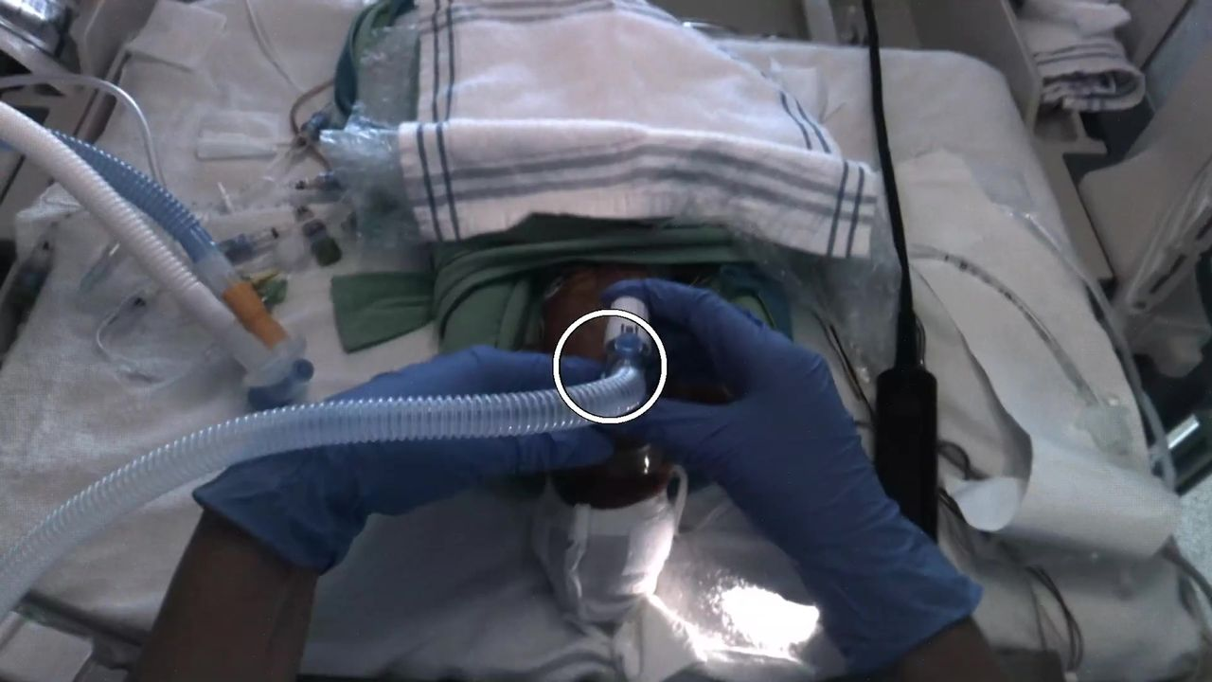
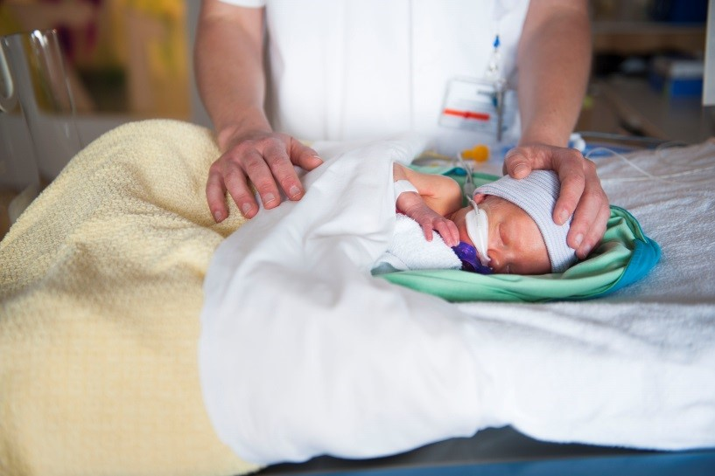
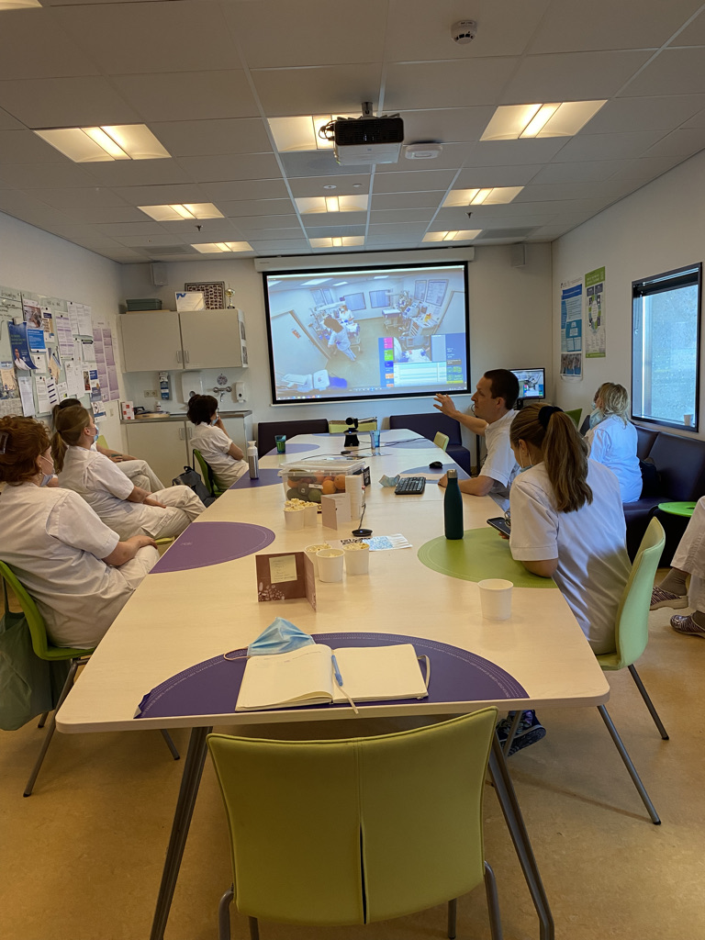
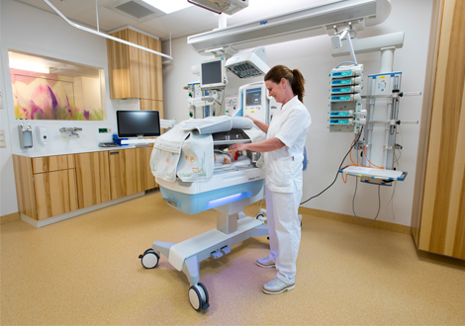
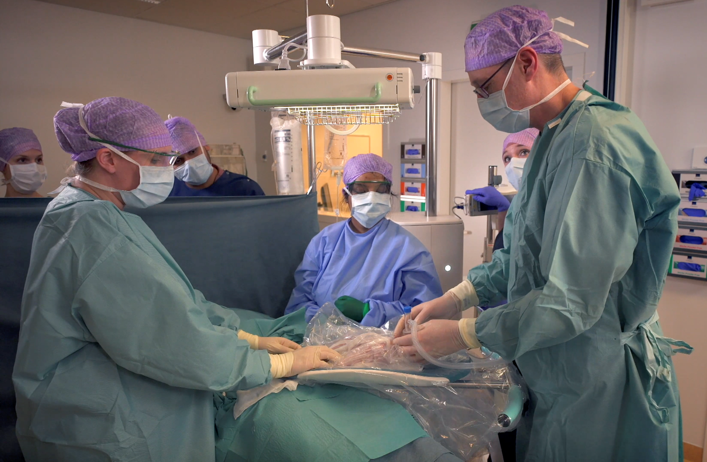
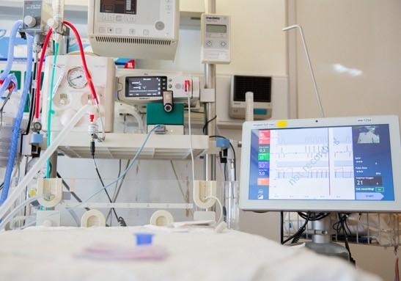
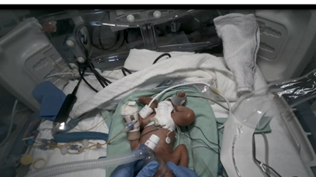
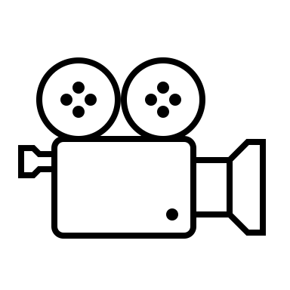
Formula 1
Emergent nature
Dynamic
Lots of factors have effect on the outcome
Multidisciplinairy
Video reflection
Notes:
How:
Debrief with the factory, on track, combining all their inputs
One of the most data driven sports in history.
Over 200 sensors that collect data on the car for analysis
Dynamic
Multi-disciplinary
Exciting
Fast
https://www.mercedesamgf1.com/en/news/2018/03/insight-how-an-f1-team-debriefs-after-a-race/
Before I walk you trough the steps our department has taken to come to this, I want to start with explaining the goal of video reflection with an example of Formula 1. It is a sport that has an emergent nature, it is very dynamic, and many factors (also some that you can’t influence) have an effect on the outcome. For the fans, look at the final grand prix of this year, where Max Verstappen won the race; this was a very unexpected outcome. To win the race, the drivers work together with all the people on track, the engineers and mechanics in the factory and many others.
So how do you win a race? Formula 1 is one the most data driven sports in history. A car has over 200 sensors that genenerate data during the race. and the key to win is to analyze and interpret that data. And that is why formula 1 has many, many team debriefs with the team, combining their inputs and perspectives to showcase a full overview of exactly what went down. Good race or bad, there's always a lot to talk about

Slide 5
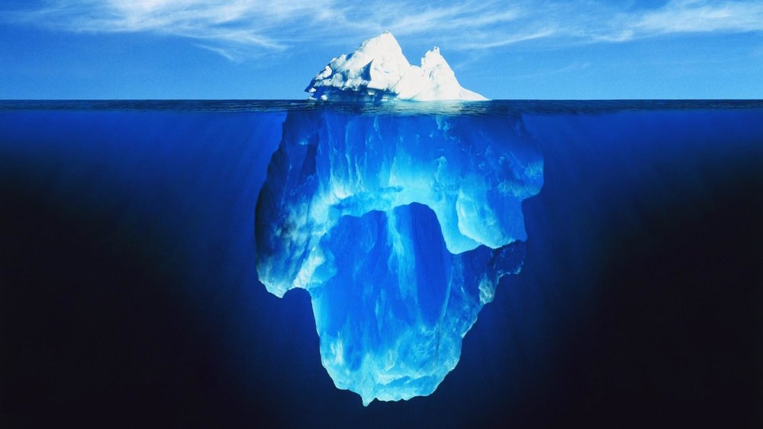
Recording neonatal interventions
Goal: to visualize neonatal interventions
Comparing work-as-done with work-as-imagined.
Objective data
No ‘recall bias’
Schilleman et al. (2014): documentation is often inaccurate
Other caregivers can benefit
Single-room switch
Continuous evaluation of care
Improvement on the long term

Slide 6
How video reflection started
Trauma
Peltier et al.
USA
Teaching
1969
Neonatology
Carbine en Finer et al.
USA
Neonatal resuscitation
2000
Video review is used in about 50 centers:
Guideline adherence
Technical evaluation
Patient outcomes
Non-technical evaluation
(Brogaard et al. 2019)
Now

Slide 7
LUMC | how it started
Research | curiosity
Effect prolonged inflations; recordings showed when exactly what was happening (van Vonderen et al. 2014)
Compare mask with nasal tube for stabilization of preterm infants at birth; time between intervention and effect (van Vonderen et al. 2015)
Guideline compliance, evaluation of mask technique (Schilleman et al. 2012)
Documentation (Schilleman et al. 2014)
→ Provides extra details for research purposes
2009
Notes:
Schilleman (2012): afwijken van richtlijnen en inadequate maskertechniek
Schilleman (2014): Documentatie in dossier is incompleet / inadequaat
Den Boer (2019): Zorgverleners zijn positief, raden het aan.
Root (2019): guideline compliance verbetert

Slide 8
LUMC | Reviewing with parents
Parents reviewed neonatal resuscitation
Valuable, comforting, family-centered care (den Boer et al. 2021)
Recording where only hands of caregiver are visible
Standard care since 2016 and part of medical file
2010
Notes:
Schilleman (2012): afwijken van richtlijnen en inadequate maskertechniek
Schilleman (2014): Documentatie in dossier is incompleet / inadequaat
Den Boer (2019): Zorgverleners zijn positief, raden het aan.
Root (2019): guideline compliance verbetert

Slide 9
LUMC | Videoreflection
Weekly review sessions of neonatal stabilization
Recordings of the hands of the caregivers and RFM
Caregivers are positive, recommend it (den Boer et al. 2019)
Improvement in guideline compliance (Root et al. 2019)
Insight in use of medical equipment, studies, clinical decision making
2014
Notes:
Schilleman (2012): afwijken van richtlijnen en inadequate maskertechniek
Schilleman (2014): Documentatie in dossier is incompleet / inadequaat
Den Boer (2019): Zorgverleners zijn positief, raden het aan.
Root (2019): guideline compliance verbetert

Slide 10

Introducing NEOFLIX video reflection sessions
2021
Notes:
Schilleman (2012): afwijken van richtlijnen en inadequate maskertechniek
Schilleman (2014): Documentatie in dossier is incompleet / inadequaat
Den Boer (2019): Zorgverleners zijn positief, raden het aan.
Root (2019): guideline compliance verbetert

Slide 11

TRAILER
Video

Slide 12
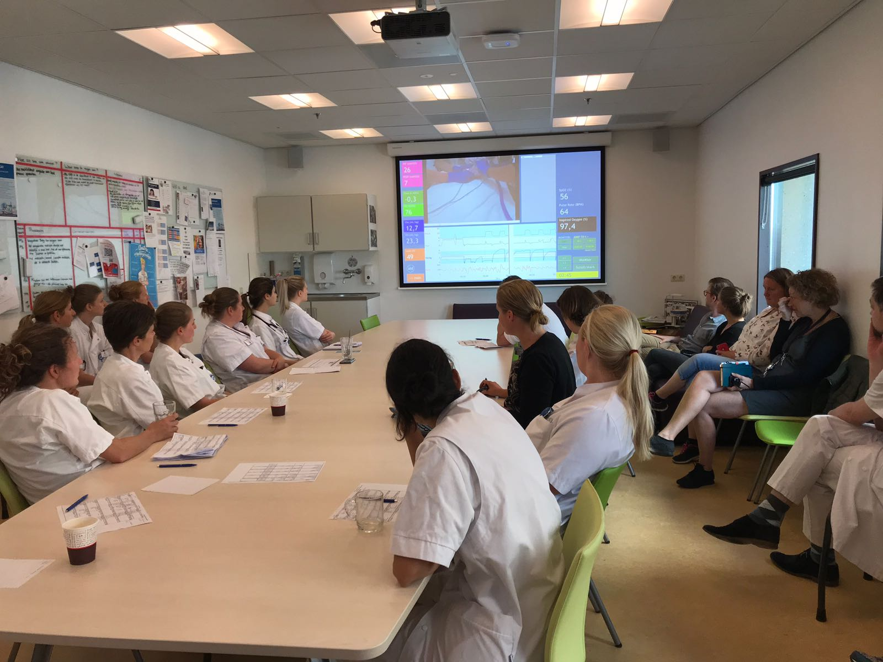
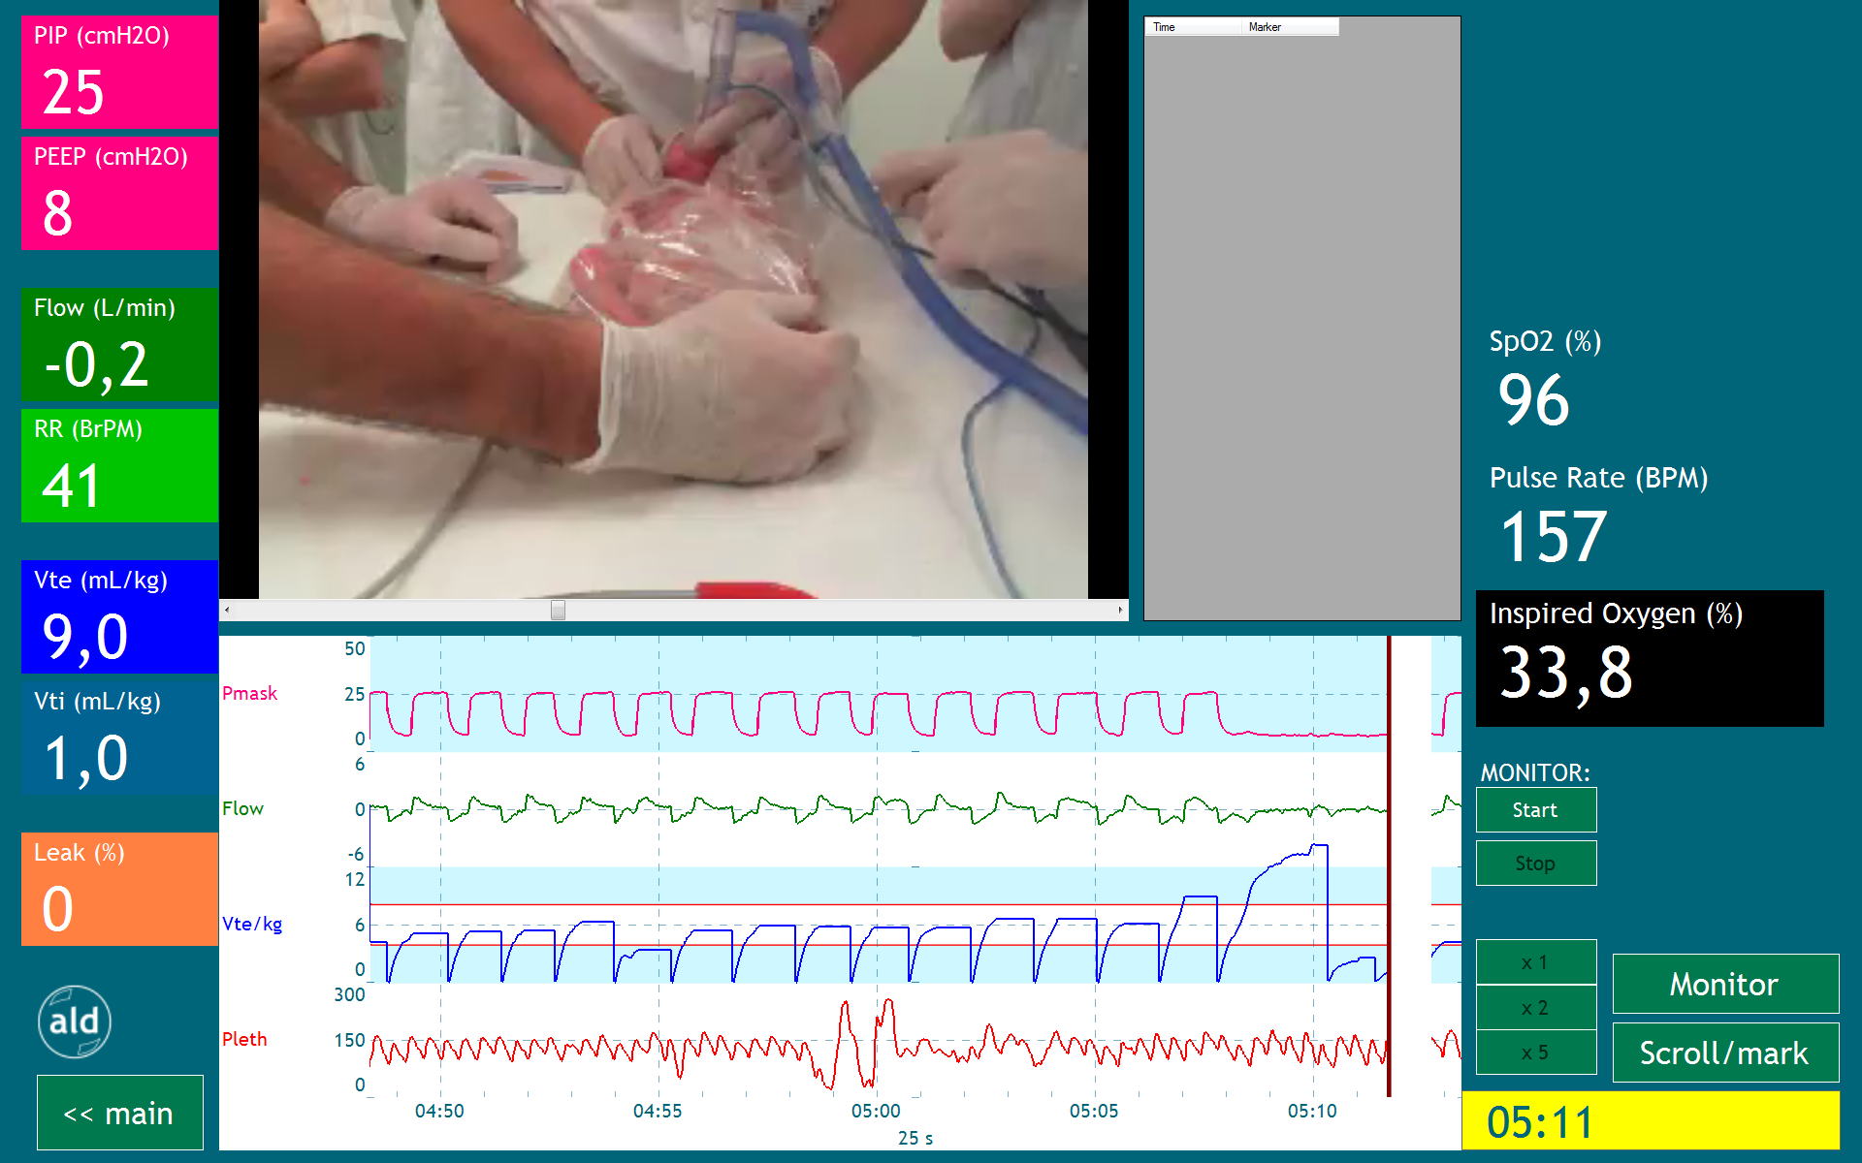
Video reflection
Notes:
1200 sensoren op een auto die data genereren die kan worden geevalueerd.

Slide 13

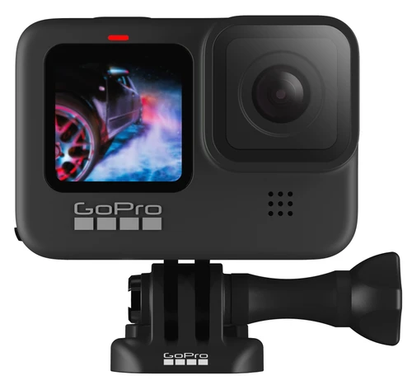
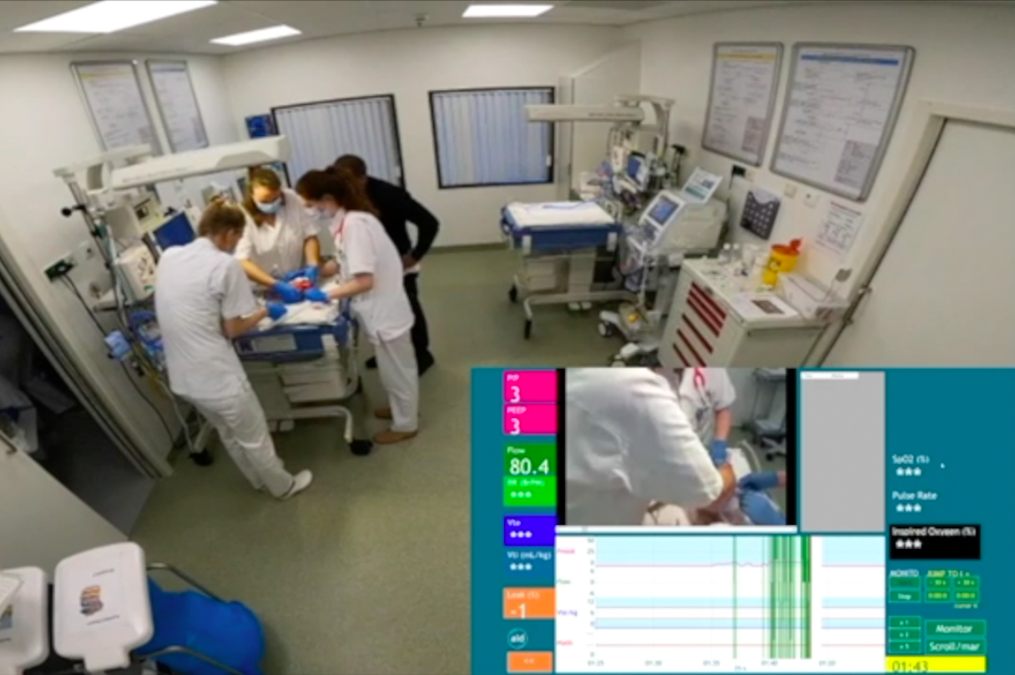
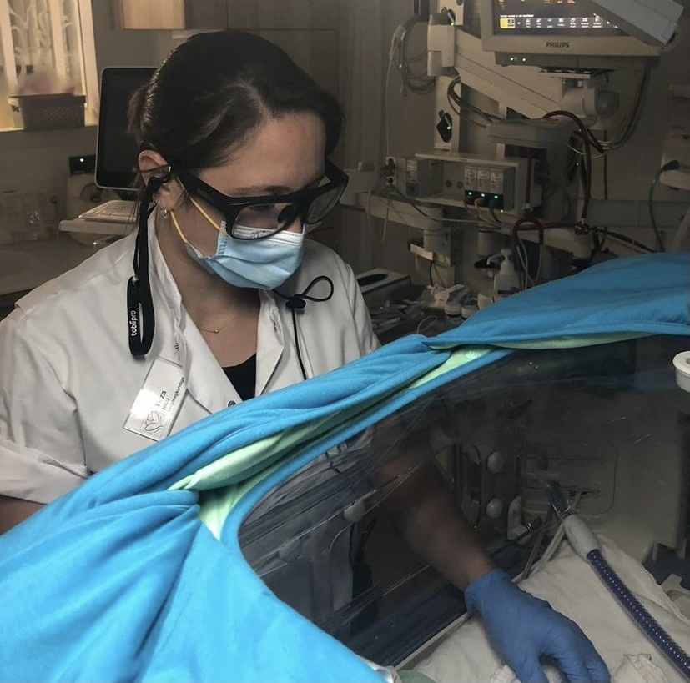
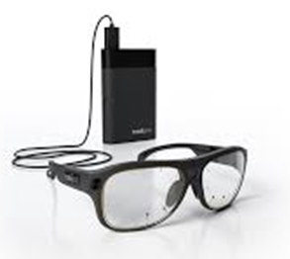
Video reflection
Notes:
1200 sensoren op een auto die data genereren die kan worden geevalueerd.

Slide 14
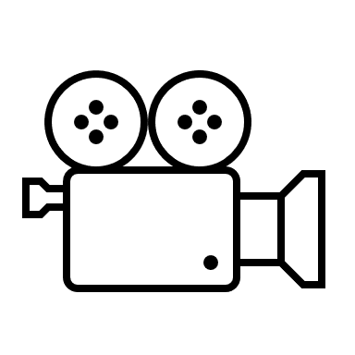

NEOFLIX
Continued with review of neonatal resuscitation
Added review of:
Intubations
MIST-procedures
Insertion of lines
Tobii glasses with eye-tracking:
“Point-of-view” recording.
Possible, educational benefit, glasses are comfortable (Wagner et al. 2021)
GoPro / audio during neonatal stabilization:
Teamwork
Williams et al. (2010): CRM during neonatal stabilization
Communication
Härgestam et al. (2016): non-verbal communication in trauma care
Leadership
(Sarcevic et al. 2011): leadership structures in trauma care
Notes:
Eye-tracking devices traditionally used for simulation-based training.
Traditional method of video recordings is by using a standard camera, positioned somewhere.
New method: eye-tracking device with first-person point of view.
This technology is integrated with point-of-view recordings taken by a camera positioned on the front of the glasses to create an audiovisual recording showing what was “seen” by the wearer along with a gaze marker demonstrating the precise visual attention (VA). Eye-tracking has been used in neonatal resuscitation, including examining HCPs’ VA during simulated and real-life cases and assessing the effect of environmental modifications on VA.
Previous eye-tracking studies have focused on quantifying visual attention and distraction, although they provide an in-depth exploration of the entire surroundings and context in which the procedure is being carried out.
In studies involving health-care providers wearing eye-tracking devices to provide real-time feedback during the clinical care of a newborn.
Eye-tracking devices can thus provide data that reflect health-care providers’ proficiency and expertise, with insight into their first-person view and visual attention during clinical care on different areas of interest (AOIs).
Used to augment and adapt clinical care and training.
Real time streaming and feedback and therefore useful for training.
Wearing the glasses not perceived as disturbing or uncomfortable.

Slide 15
Conditions (1)
Essential: safe learning environment!
NEOFLIX:
Multidisciplinary – nurses & docters
Goal: learn together from daily practice; as much as possible should go right.
Feedback rules
Presence of ‘cast’
Notes:
Concerns centered primarily on the identification of clinicians, accountability and the generation of ‘‘evidence’’ in the event of medical/nursing error. Also raised were the consent process, data management and availability and the identification of the subjects.
Position on these issues evolved into the following: c When resuscitation occurs, staff attendance is recorded and medical notes are documented. The identification of staff present at resuscitation is therefore mandatory irrespective of the act of video recording.
c Disclosure of medical error is standard practice whether it is captured on a video recording or not.
c Video data is likely to document some medical errors. It is, however, more likely to provide evidence of good practice, rather than errors that may adversely affect outcome.
c It is incumbent upon us to subject our performance to quality assurance.

Slide 16

Conditions (2)
Privacy
Recordings of the hands of the caregivers during neonatal stabilization are standard care and part of medical record
Recordings eye-tracking glasses / GoPro → quality assurance
Accessible only by dedicated Neoflix members
Opt-out for caregivers→ no recording.
Extra consent for use of recordings in Neoflix reflection sessions.
Data storage on secure disc & deletion afterwards.

Slide 17
NEOFLIX | study
To describe the process of learning from videoreflection of daily neonatal interventions
To explore how to make implementation of videoreflection successful
Intubations
Line insertions
Neonatal resuscitation
Privacy
Technical aspects
Logistics
Safe learning environment

Slide 18
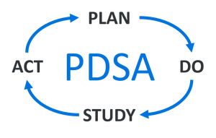
Improving complex care
Observations, questionnaires, interviews and Neoflix evaluation group.
Action research
Lessons learned:
Intubations
Line insertions
Neonatal resuscitation
Commands training
Protocol adjustments
Emphasize communication in training
Implementation:
Privacy
Technical aspects
Logistics
Safe learning environment
Wireless microphone installation
Switch in time
Tasks of chairman

Slide 19
To conclude
NEOFLIX | Video reflection
Enthusiastic
Offers many possibilities and insights to improve care
Preconditions need to be considered carefully
Video reflection sessions give the caregiver a safe platform
To discuss neonatal interventions and how they wish to improve and change

Slide 20

Questions?
NEOFLIX@lumc.nl
v.heesters@lumc.nl

Slide 21
Referenties
Schilleman K, Witlox RS, van Vonderen JJ, Roegholt E, Walther FJ, te Pas AB. Auditing documentation on delivery room management using video and physiological recordings. Arch Dis Child Fetal Neonatal Ed 2014;99(6):F485-90.
Peltier LF, Geertsma RH, Youmans RL. Television videotape recording: an adjunct in teaching emergency medical care. Surgery. 1969;66(1):233-6.
Carbine DN, Finer NN, Knodel E, Rich W. Video recording as a means of evaluating neonatal resuscitation performance. Pediatrics. 2000;106(4):654-8.
Brogaard L, Uldbjerg N. Filming for auditing of real-life emergency teams: a systematic review. BMJ Open Qual. 2019;8(4):e000588.
van Vonderen JJ, Hooper SB, Hummler HD, Lopriore E, te Pas AB. Effects of a sustained inflation in preterm infants at birth. J Pediatr 2014;165(5):903-8.e1.
van Vonderen JJ, Kamlin CO, Dawson JA, Walther FJ, Davis PG, te Pas AB. Mask versus nasal tube for stabilization of preterm infants at birth: respiratory function measurements. J Pediatr 2015;167(1):81-5.e1.
Schilleman K, Siew ML, Lopriore E, Morley CJ, Walther FJ, te Pas AB. Auditing resuscitation of preterm infants at birth by recording video and physiological parameters. Resuscitation 2012;83(9):1135-9.
den Boer MC, Houtlosser M, Witlox R, van der Stap R, de Vries MC, Lopriore E, et al. Reviewing recordings of neonatal resuscitation with parents. Arch Dis Child Fetal Neonatal Ed. 2021;106(4):346-51.
den Boer MC, Houtlosser M, Foglia EE, Tan RNGB, Engberts DP, te pas AB. Benefits of recording and reviewing neonatal resuscitation: the providers’ perspective. Arch Dis Child Fetal Neonatal Ed 2019;104: F528-F534.
Root L, van Zanten HA, den Boer MC, Foglia EE, Witlox R, Te Pas AB. Improving Guideline Compliance and Documentation Through Auditing Neonatal Resuscitation. Front Pediatr. 2019;7:294.
Wagner M, den Boer MC, Jansen S, Groepel P, Visser R, Witlox R, Bekker V, Lopriore E, Berger A, Te Pas AB. Video-based reflection on neonatal interventions during COVID-19 using eye-tracking glasses: an observational study. Arch Dis Child Fetal Neonatal Ed. 2021;
Williams AL, Lasky RE, Dannemiller JL, Andrei AM, Thomas EJ. Teamwork behaviours and errors during neonatal resuscitation. Qual Saf Health Care. 2010;19(1):60-4.
Härgestam M, Hultin M, Brulin C, Jacobsson M. Trauma team leaders' non-verbal communication: video registration during trauma team training. Scand J Trauma Resusc Emerg Med. 2016;24:37.
Sarcevic A, Marsic I, Waterhouse LJ, Stockwell DC, Burd RS. Leadership structures in emergency care settings: A study of two trauma centers. International Journal of Medical Informatics. 2011;80(4):227-38.

